Slide 1

Amending the Food Distribution in Highland Park
Presented By: Avantika Yellapantula

Slide 2
A Special Welcome To:
Kim Patton, Director of Foundation Center, New York

Slide 3
Agenda
Setting
The Problem
Effects of a poor model
Why it important to act now
Current/Pilot Models
Proposed Models
Plan
Budget

Slide 4
Setting
Food Insecurity
Food Banks/Pantry
Reduce Food Waste
Unbalanced Meals
Lack of balanced food distribution
Raise Low Water Productivity
Nutrition-related Health risks
Notes:
What is Food Insecurity?
the state of being without reliable access to a sufficient quantity of affordable, nutritious food.
"more than 800 million people live every day with hunger or food insecurity as their constant companion“
Many Nations come together to increase food security within their own countries
Food Waste – freezing bread, sliced fruit, or meat
Raise Low Water Productivity - raising irrigation efficiency

Slide 5
Food Banks and Food Pantries
Supermarket (ShopRite)
Food Bank (NJ Food Bank)
Highland Park Food Pantry
Rutgers Food Pantry
South Brunswick Food Pantry

Slide 6
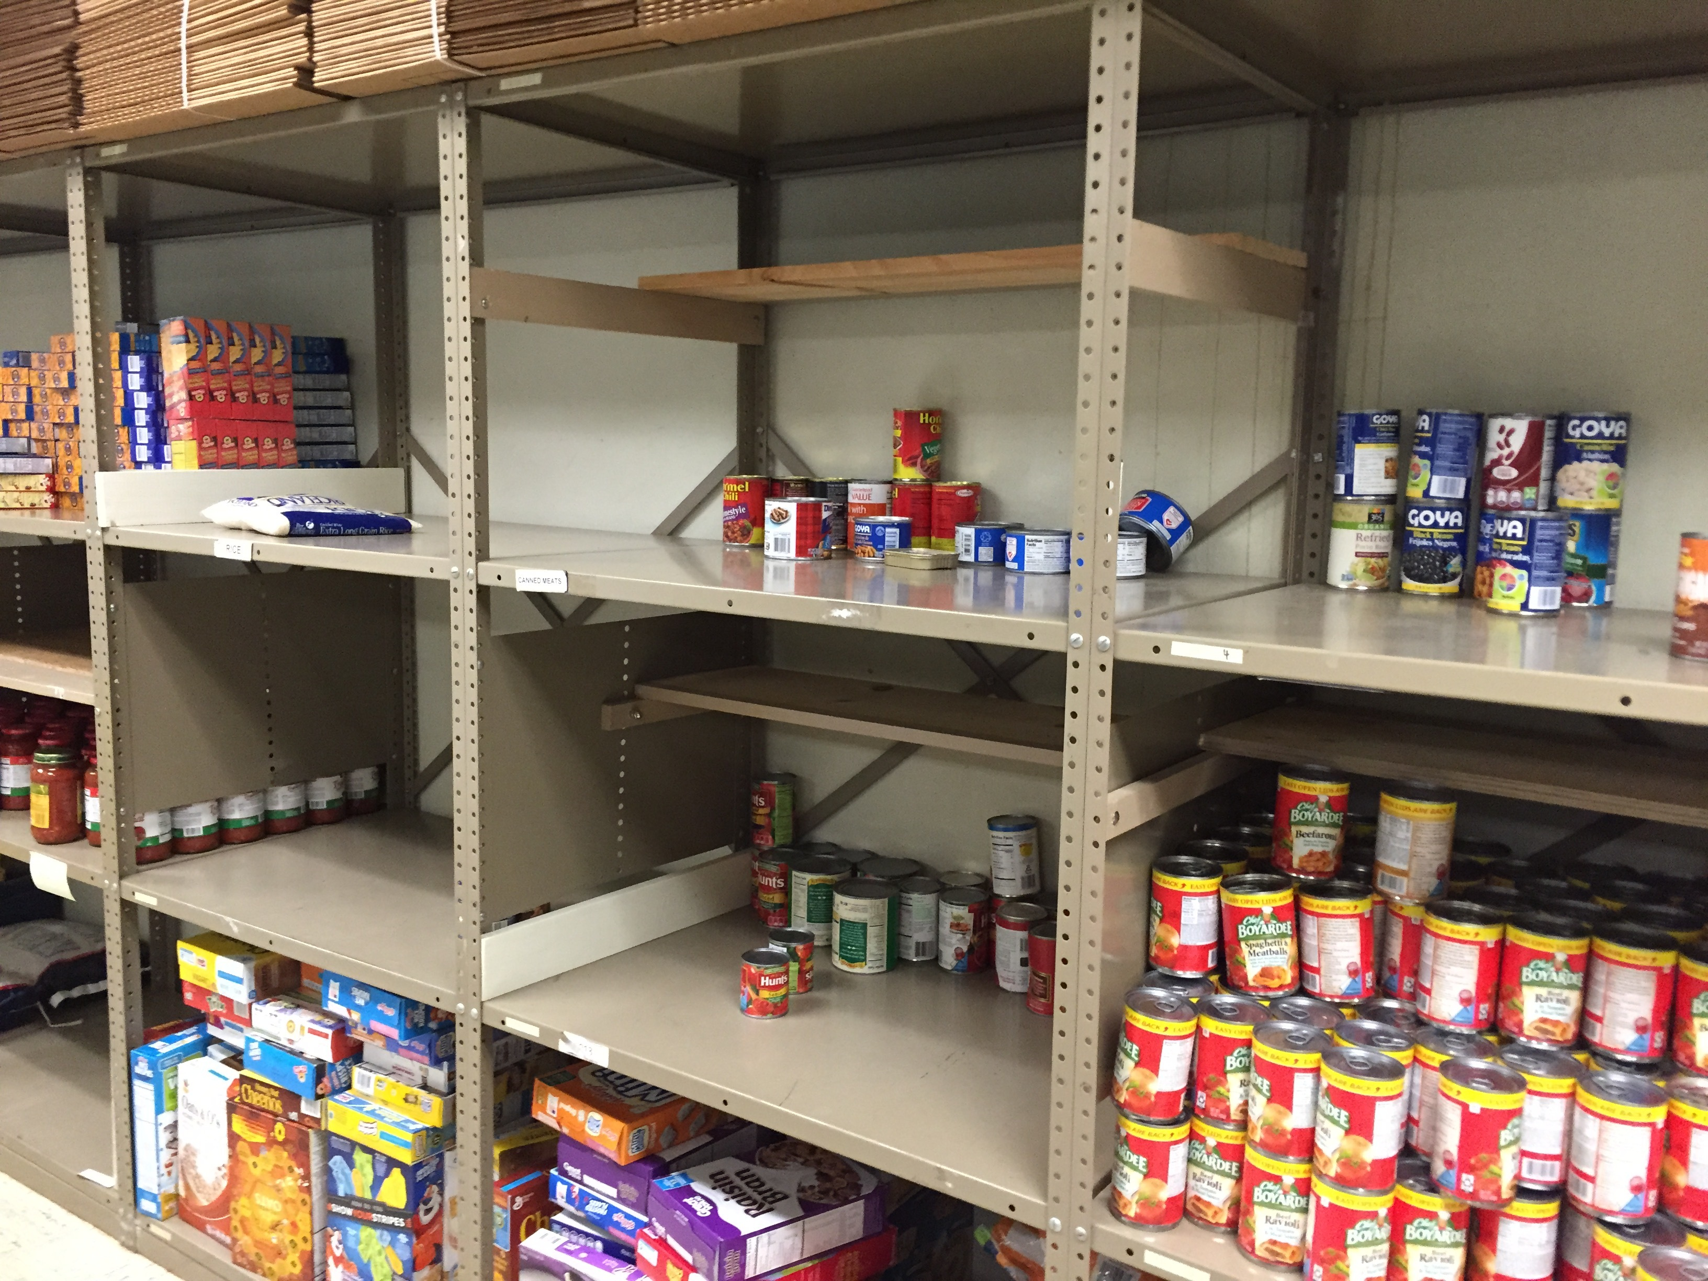
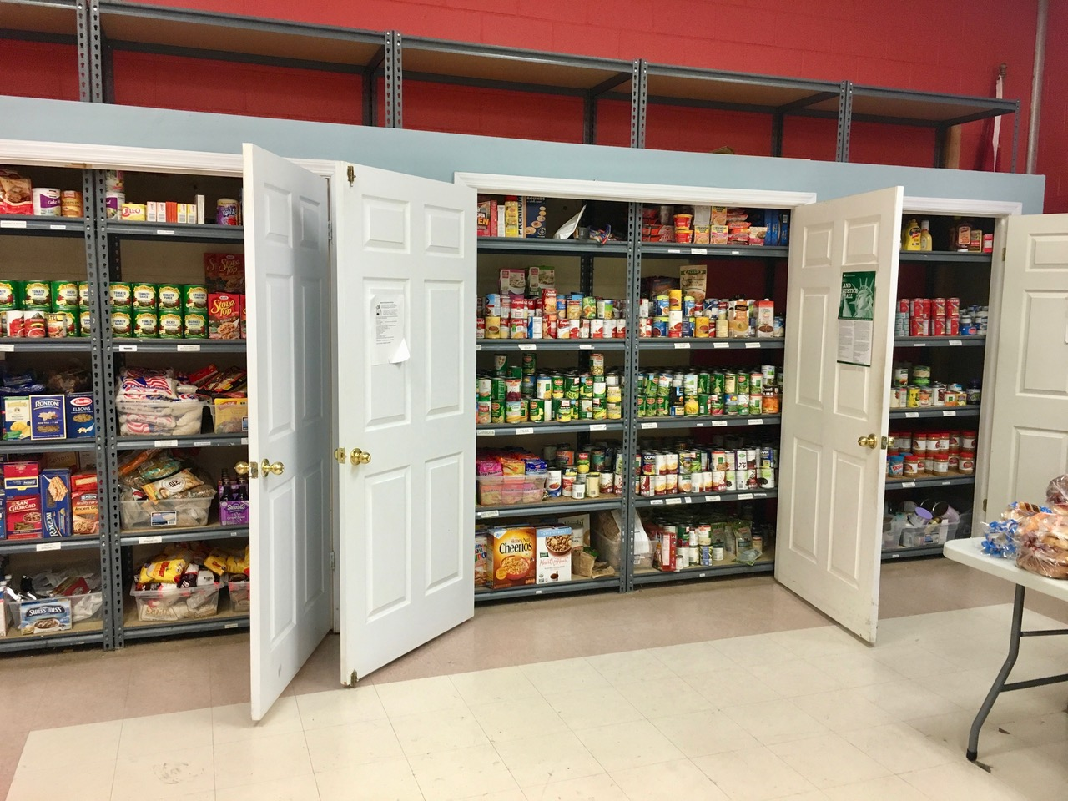
The Problem in Highland Park
Figure 2. Shows the emptier cupboard of donations in the Highland Park Food Pantry. Retrieved from http://www.hpboro.com/index.aspx?NID=539

Slide 7
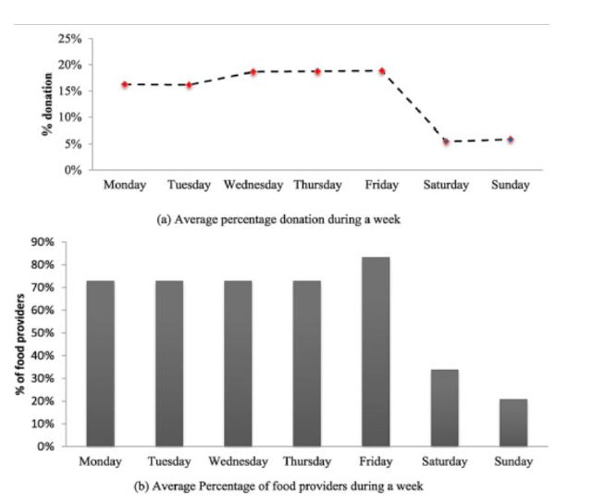
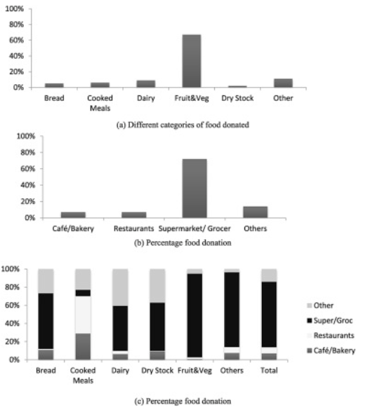
Figure 4. Shows the lack of donations received by food banks/pantries. Retrieved from https://www.sciencedirect.com/science/article/pii/S0038012116300453?via%3Dihub

Slide 8
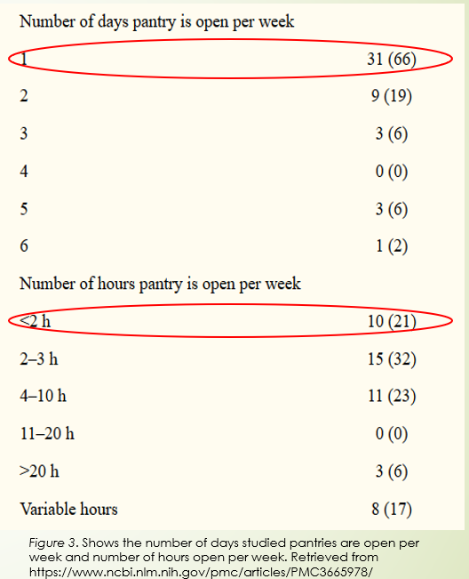
Effects of a poor Model
Depends on the uses of a food pantry and the management style/model implemented there
Senior Lecturer in Birmingham City University
Noted that food pantries often have customers that are long-term users of food pantries
Food Pantries often give more processed food, than fresh produce
Children would become deficient in fiber, calcium, iron, variety of vitamins
The pantry ends up as more of an inconvenience than it is part of a solution.

Slide 9
Why Act Now?
Current Economic Climate
Difficult for some to manage financial obligations
Gaps between donations are getting longer and donations are becoming fewer
Long-term effects start the vicious cycle again
Donations by everyday folk are often random and not in any particularly proper measurement
Causes model for food distribution to weaken

Slide 10
Current or Proposed Models
Meals for Good
Using food-banks as a catering option for children in early care and education programs
Altering the Donation/Distribution Algorithm
Estimating the availability of donations in the absence of information through a machine-learning algorithm
Food bank system comparison
Understanding the differences and similarities between the food banks in Korea and USA

Slide 11
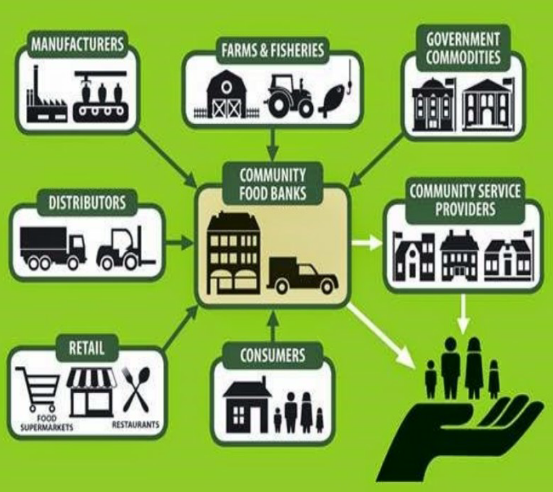
Meals for Good
Objective
Test the feasibility of implementing a food-bank based catering model to provide more nutritious meals for free compared to meals brought from home (parent-prepared meal)
Process
A Menu Analysis was conducted
Result
Food Bank catering showed daily reductions in:
Conclusion
Conclusion
Compared the nutrition of the food-bank based meals with the parent-cooked meals
Food Bank Catering to four privately owned Early Care and Education (ECE) programs
Calories
Fat/Saturated Fat
Food Bank catering showed increases in sodium
In this pilot version of this idea, it seemed that the Food Bank Catering was better for the children than home-made meals
Solution provides a way for food banks to be taken care of by those who are invested in the care of children.
Donations could increase
Public Schools
Notes:
However:
The food bank would need to be heavily sponsored for this
It would require a significant portion of food bank food items being sequestered specifically for children rather than those in need
With inflation for the prices of food, it would already be further difficult for food banks to store donations and food

Slide 12
Altering the Donation/Distribution Algorithm
Objective
To estimate the costs and losses for Food Banks caused by supermarkets and other major donators not providing information in regards to what items are available to donate
This can negatively impact inventory management capabilities and cause unnecessary transportation costs
Process
Using a subset of the historic data provided by the Food Bank of Central & Eastern North Carolina (FBCENC)
Tests four approximation methods to estimate collection amounts and transportation costs
Result
Suggests that the machine-learning neural network algorithm provides the best approximations for each food type and provide better estimates
Conclusion
Tenable idea
Would work better with a larger focus
Doesn’t discuss distribution explicitly

Slide 13
Food bank system comparison
Objective and Process
To compare and contrast the food bank systems in Korea and the United States
Result
Korea imitated the USA model
Conclusion
Not really a tenable idea
Would work better with a larger focus, since we would be implementing another nation’s model
Doesn’t discuss distribution of any kind explicitly
Successfully decide which nation’s program can be implemented in certain cities/states
However:
In the USA, founded on a community-based model, food banks with strong autonomy actively cooperate with other actors in a diverse network mode
Korea has a state-centered model under which food banks have weak autonomy and interact sparely with other stakeholders in a more standardized mode

Slide 14
Plan
Objective:
Altering the Food Pantry/Food Bank model in Highland Park to become more efficient
Procedure
Start from the Food Bank
Implement the MLP-NN model from the previously discussed model
This would alter the distribution cycle to a more efficient stream of food to the food bank
Food Bank to Food Pantry
Create a stochastic Markov decision process to track the food bank’s inventory system
Improving the Food Pantry
Use the model to create more feasible, useful plans for donations and transportations
Optimal allocation for each person/USDA bag

Slide 15
Budget
Research | Cost
Researchers within the university Graduate Students 3 members | $20 per hour 12 weeks 10 hours per week = $20x10x12 = $2400 = $7200
Team Coordinator & Liaison between Research and Food Bank - 1 member | $25 per hour 12 weeks 12 hours per week = $3600
Equipment and Supplies | Cost
Computer Equipment | $2,000 per individual
Checkout Barcode Scanners (5) | $400 per scanner = $2000
Total | $12,800

Slide 16
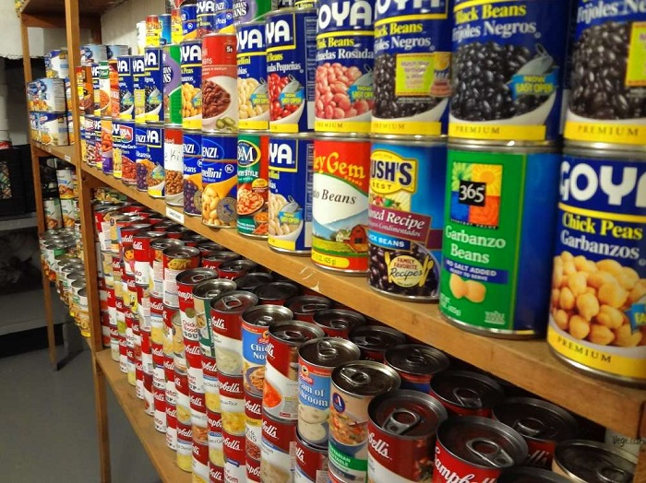
Thank You! Questions?

